Slide 1


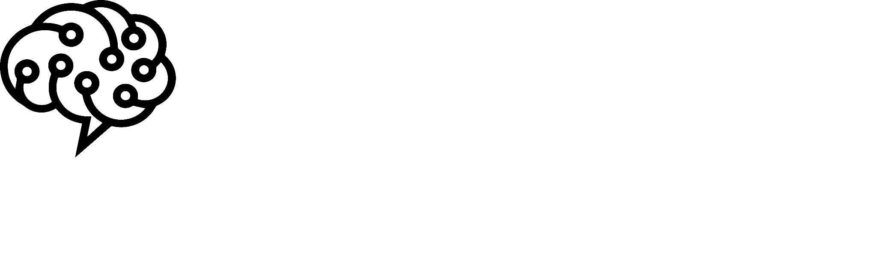
Hello and Welcome to
AI Camp

Slide 2
Deep learning in NLP
Youcef Benali
HR manager of SOAI
Software engineering student at ESI Algiers

Slide 3


What we’ll see today?
Introduction
ML limits in NLP
Deep learning in NLP
Recurrent neural networks
Advanced RNNs
LSTM
GRU
Demo
Questions

Slide 4

Natural language processing
Translation
Question answering
NLP
Sentiment analysis
Text generation
Named entity recognition
Auto-complete

Slide 5

PROBLEM
Computers understands only numeric data
Solution
Text preprocessing + word embeddings

Slide 6
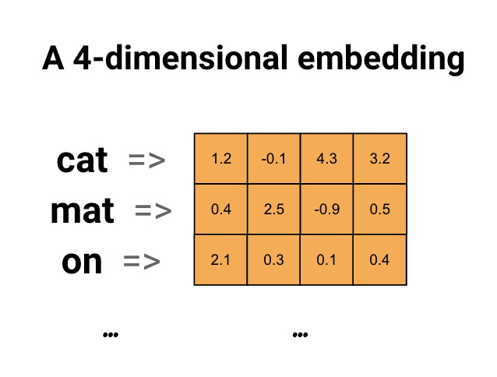

Slide 7


Prediction
Text
Word embedding (input)
ML model
Depends on the task

Slide 8
Machine learning in NLP
Classification tasks (Spam detection, sentiment analysis)
Naive Bayes
Random Forests
…
Regression (imdb movie score)
Gradient boosting
Linear regression
…

Slide 9
Limits of ML

Slide 10
Large Datasets for better accuracy

Slide 11
2. Complex tasks
(nlp is not just spam detection)

Slide 12
3. ML models can’t handle dependency between words
(This is our main topic today)

Slide 13
Deep learning and NLP

Slide 14
Deep learning and NLP
Machine learning gives good results in simple tasks with small datasets like sentiment analysis or text classification, but there are some cases where we should use a more complex model to recognize hidden patterns and gives other type of output, that’s where we prefer to use deep learning and neural networks

Slide 15
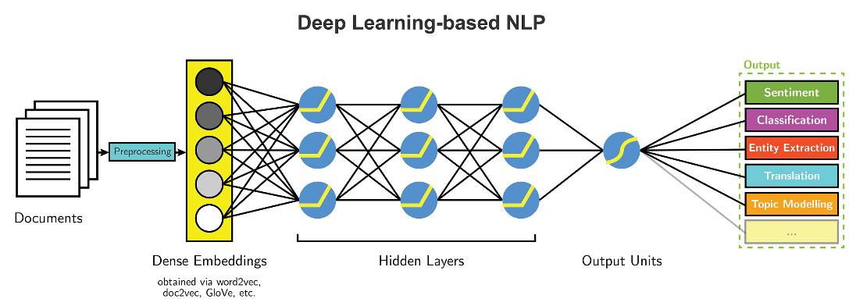
Data goes in one direction with no loops

Slide 16
What you’ve seen is called : feed forward NN
It’s the most basic type of neural networks, but it has some limitations:
Has a fixed-sized input and returns fixed sized output
No memorization of previous or next data
Which will cause a real problem where dealing with sequence data like nlp or time series

Slide 17
Example:
despite the bad acting, This movie had a great story and I like it
Problem: If we have to calculate the score of this movie, simple NN can ignore the bad acting and gives the movie 10/10: no context understanding
Solution: Recurrent neural network

Slide 18
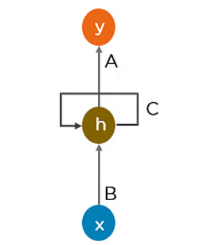
Recurrent neural networks (RNN)
RNN works on the principle of saving the output layer and feeding it back to the input for the output prediction
Can handle sequence data
consider the current and previous input
Internal memory: to memorize the hidden state

Slide 19
Recurrent neural network
Example:
despite the bad acting, This movie had a great story and I like it
x<1>
x<2>
x<3>
x<4>
… ….
x<T>
Don’t forget, each x<i> is a vector of numbers (result of embedding)

Slide 20
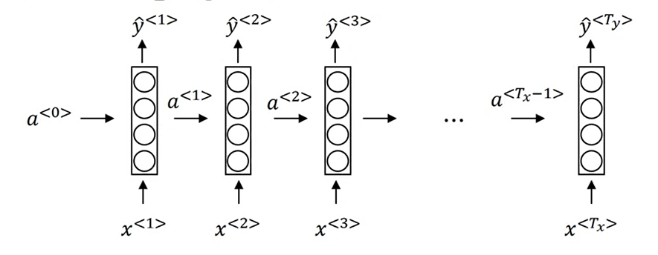
Recurrent neural network
Vector of zeros (generally)
Wya
Wya
Wya
Waa
Waa
Waa
Wax
Wax
Wax
a<t> = f(Waa . a<t-1> + Wax . x<t> + ba) f usually is tanh
y<t> = g(Wya . a<t> + ba) g depends on the task (sigmoid, softmax …)

Slide 21
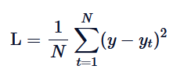
Backpropagation through time
Wy,by
Wa,ba
Loss function: MSE

Slide 22
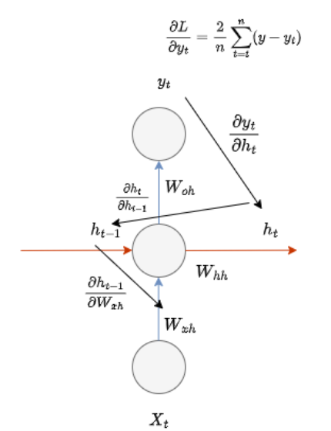
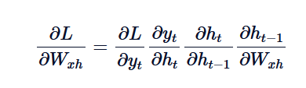
Backpropagation through time

Slide 23
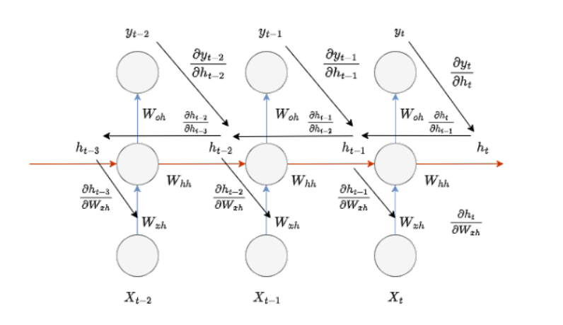
Backpropagation through time

Slide 24
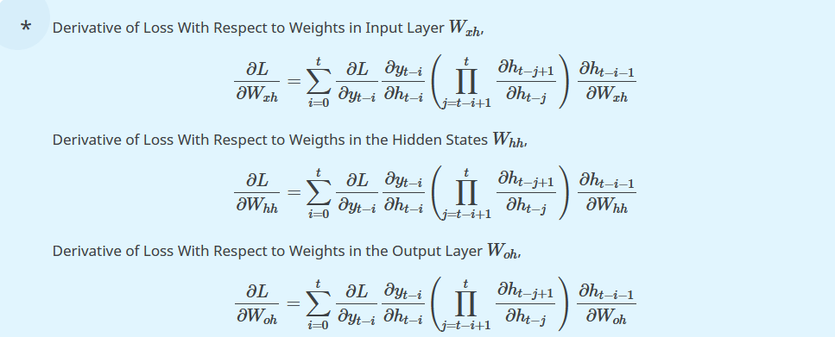
Backpropagation through time
Wrap up (Equations of weights and biases)

Slide 25
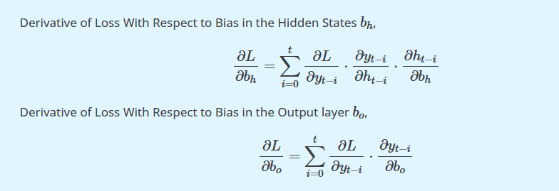
Backpropagation through time
Wrap up (Equations of weights and biases)

Slide 26
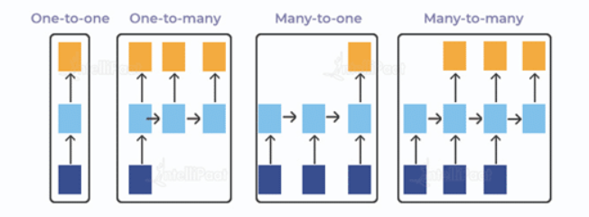
Types of RNN

Slide 27
Advanced RNNs
Gate recurrent unit (GRU)
Long short Term Memory
(LSTM)

Slide 28
Motivation
vanishing gradients problem: in very deep neural networks composed of many layers with different activation functions, and in the process of back propagation, the learning of the first layers from the error can be so difficult because most of activation functions standardize weights between 0 and 1 so the values will be so small to make an update

Slide 29
Motivation
It’s so important in NLP because there are dependencies that should be memorized earlier, and RNNs don’t have this advanced mechanism
Example
The cat, which already ate …… , was full
The cats, which already ate …… , were full

Slide 30
solution?
Use a memorization mechanism

Slide 31
Advanced RNNs
Gate recurrent unit (GRU)
Long short Term Memory
(LSTM)

Slide 32
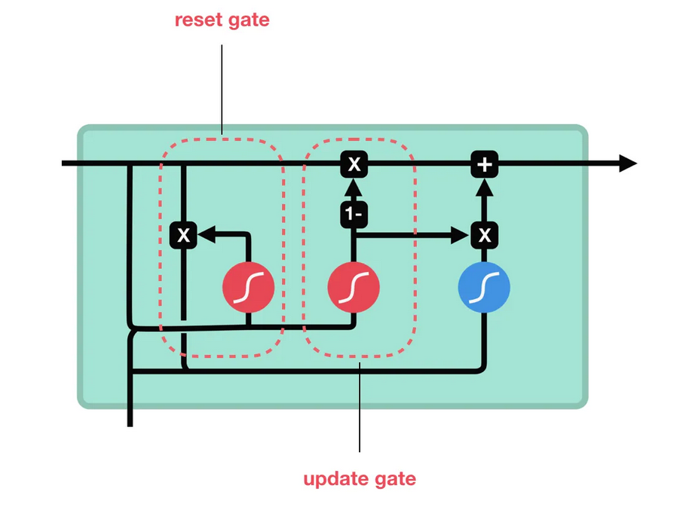
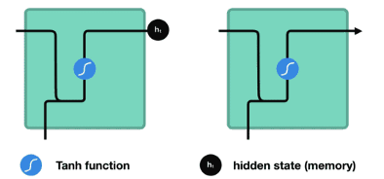
Gated recurrent unit (GRU)
RNN
GRU

Slide 33
GRU has two gates
update gate (u)
reset gate (r)

Slide 34
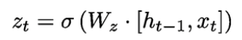
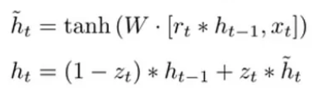
Update gate ( short term memory)
It decides what information to throw away and what new information to add.

Slide 35
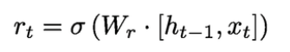
Reset gate ( long term memory)
It decides how much old information to forget

Slide 36
Advanced RNNs
Gate recurrent unit (GRU)
Long short Term Memory
(LSTM)

Slide 37
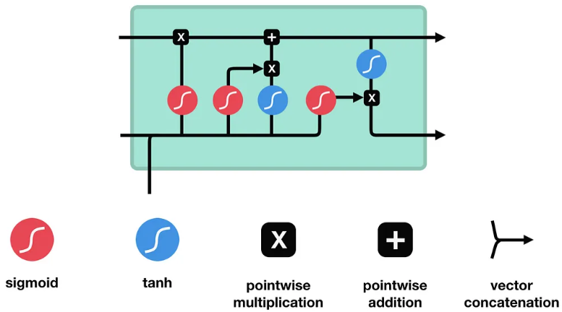
LSTM
cell state
hidden state

Slide 38
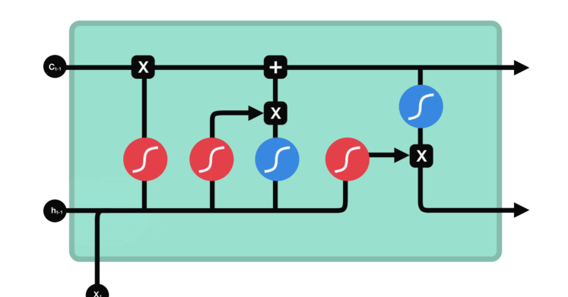
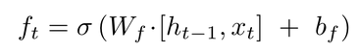
LSTM forget gate
This gate decides what information should be thrown away or kept. Information from the previous hidden state and information from the current input is passed through the sigmoid function. Values come out between 0 and 1. The closer to 0 means to forget, and the closer to 1 means to keep.

Slide 39
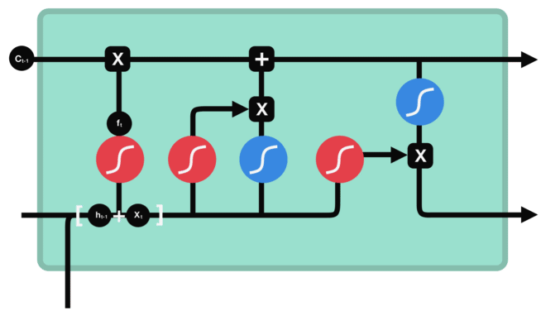
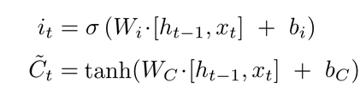
LSTM input gate
This gate adds to the current cell state the values of hidden and input states h and x,
but with deciding which info to keep and which to give up

Slide 40

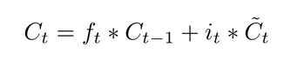
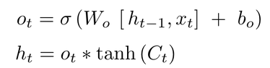
LSTM output gate
This gate gives the value of the cell state, after passing through the forget and input gates, and calculates the new hidden state by passing c(t) on tanh and multiplying it by the forget formula

Slide 41
LSTM forget gate
This gate decides what information should be thrown away or kept. Information from the previous hidden state and information from the current input is passed through the sigmoid function. Values come out between 0 and 1. The closer to 0 means to forget, and the closer to 1 means to keep.

Slide 42
coding time
building an NER model with bidirectional lstm

Slide 43
Thank you for attending
any questions ?

